Slide 1
Feasibility Report
STEVEN bOOTH, pETER hARLAN, dANIEL mONTERROSAS, mICHELLE sCHAPMIRE, zACH wATHEN

Slide 2
Introduction
Project Overview and Goals
Preliminary Requirements
Project Scope
Technical Resources
Our Approach
Technical Feasibility
Schedule Feasibility
Progress Visibilility
Initial Risk Analysis

Slide 3
Project Overview and Goals
Wikipedia is the world's largest online collaborative encyclopedia, having thousands and thousands of users from across the world contribute to a plethora of informative pages about every subject imaginable. Our goal is to create a miniature version of Wikipedia all about Western Kentucky University.
Notes:
Did this one, feel free to add to it. -S

Slide 4
Preliminary Requirements
Business considerations
Docker Book
Raspberry Pi 3
General Objectives
Create a working Mini Wikipedia with legitimate content about WKU.
Include all planned user functions for Wikipedia.*
Business Objectives
Be a useful tool for students to learn about places on campus and important staff as an interest.
Serve as a applicable tool for newer students to find or learn about places/people on campus. (Find computer labs, libraries, financial aid office, etc.)
*Listed under functional requirements.
Notes:
Did this one, feel free to add to it. -S

Slide 5
Project Scope
Project Task
Create a smaller Version of Wikipedia centered around WKU
Functional Requirements
User Levels
Admin
Member
Public User
Restoring Page Backups
Easy Page Adding and Editing
Search Function
Notes:
No clue what to put for Project Task bullet. Would delete it but I didn't put it there, someone else can work with that or cut it. -S

Slide 6
Technical Resources
Hardware Architecture
Raspberry Pi 3
Software Architecture
Front-End Frameworks
Back-End Frameworks
LAMP
MYSQL
PHP
Bootstrap
Github
PhpMyAdmin
Notes:
Done I think, although all of these can be sorted into front end or back end bullet if someone wants to. -S

Slide 7
Our Approach
Group | Team Member | Role
Front End Team | Peter Harlan Steven Booth | Front End Design Mediator
Back End Team | Zachary Wathen Daniel Monterrosas | Scripting Database
Project Manager | Michelle Schapmire | Organization
Notes:
Just put a little about roles under process, since divide and conquer is basically our process. (except on reports) -S

Slide 8
Our Approach
Communication
Weekly Meetings
GroupMe
Collaboration Tools
OneDrive
Github
Meeting Time | Meeting Type | Group A | Group B
Monday 3-4pm | In Person | Yes | No
Tuesday 4-5:30pm | In Person | Yes | Yes
Wednesday 3-4pm | In Person | No | Yes
Friday 11:30-12:25pm | In Person Client Meeting | Yes | Yes
Friday 3-4pm | Virtual | Yes | Yes

Slide 9
Technical Feasibility
The Raspberry PI is the tool which will host our little web project. It has many limitations, but will serve as a feasible outlet for this particular project.
Security
Administrative Interface
Account Privileges
The location where our PI will host from must have a decently suitable internet speed, so preferably no or low latency, and no random outages.
Backup Locations
Notes:
Drew first part from report, needed more so bull crapped that whole second thing but it is a technical thing to consider. Anyone can add/change/remove anything. -S

Slide 10
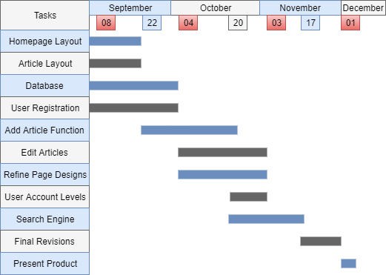
Schedule Feasibility
Notes:
Pretty much just going to leave the chart here as this slide. Make changes as needed. -S

Slide 11
Progress Visibility
Github – Accessible way to track, store, and edit all code
OneDrive – Documentation storage and access for all team members to edit

Slide 12
Initial Risk Analysis
Risk | Category | Risk Level (based on loss) | Likelihood | Impact
Lack of Time | Known-Known | Medium | Unlikely | Missed delivery dates
Lack of Experience | Known-Known | Low | Likely | Software Quality will not be good
New to Collaborative Development | Known-Known | Medium | Likely | Missed delivery dates
Loss of a team member | Unknown-Known | High | Unlikely | Development will slow down
Poor communication | Unknown-Known | Medium | Likely | Confusion on task goals

